Slide 1
Facade
- Ankur Pandey

Slide 2
Intent
Provide a unified interface to a set of interfaces in a subsystem
Defines a higher-level interface that makes the subsystem easier to use
Hides all the complex interactions between modules by the simple interface
Decouples client from implementation

Slide 3
Motivation
Structuring a system into subsystems helps reduce complexity
A common design goal is to minimize the communication and dependencies between subsystems. One way to achieve this goal is to introduce a facade object that provides a single, simplified interface to the more general facilities of a subsystem

Slide 4
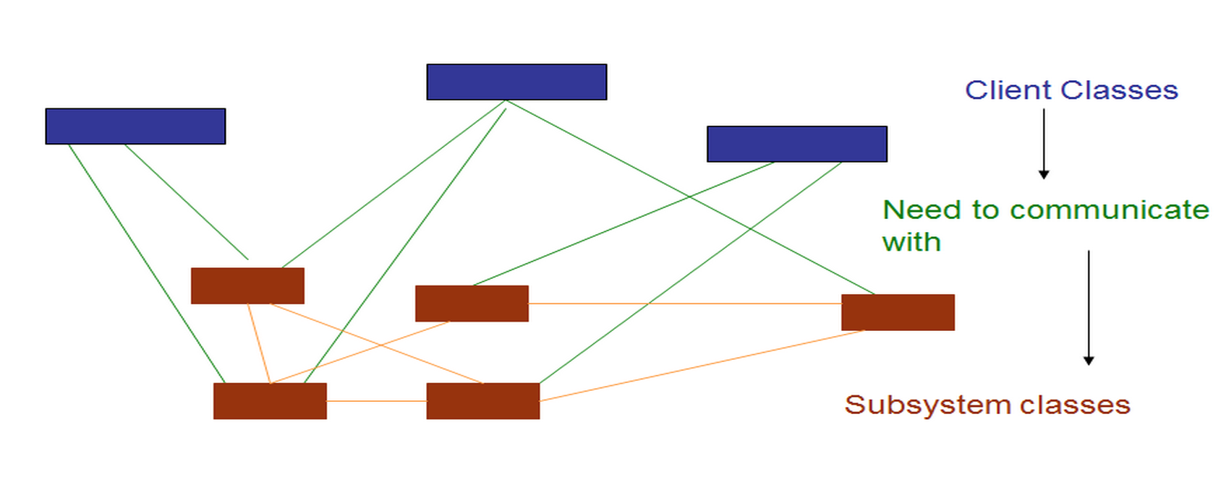
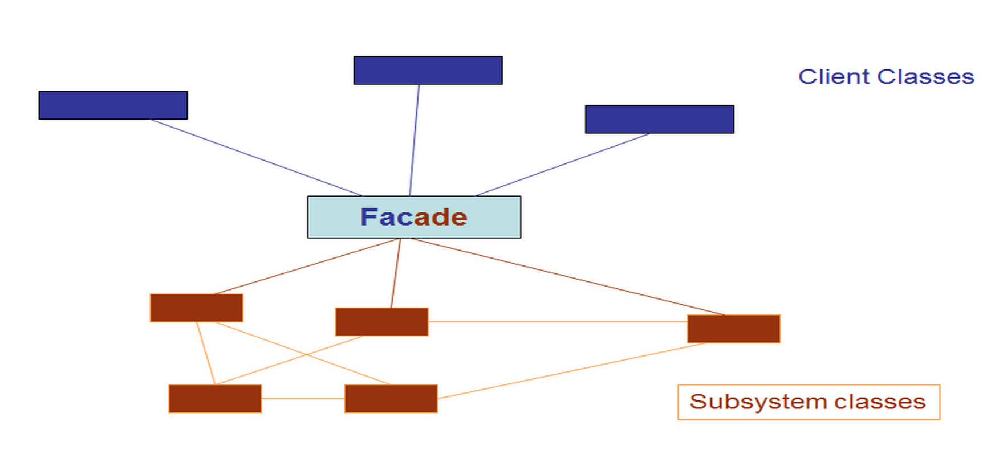
Motivation

Slide 5
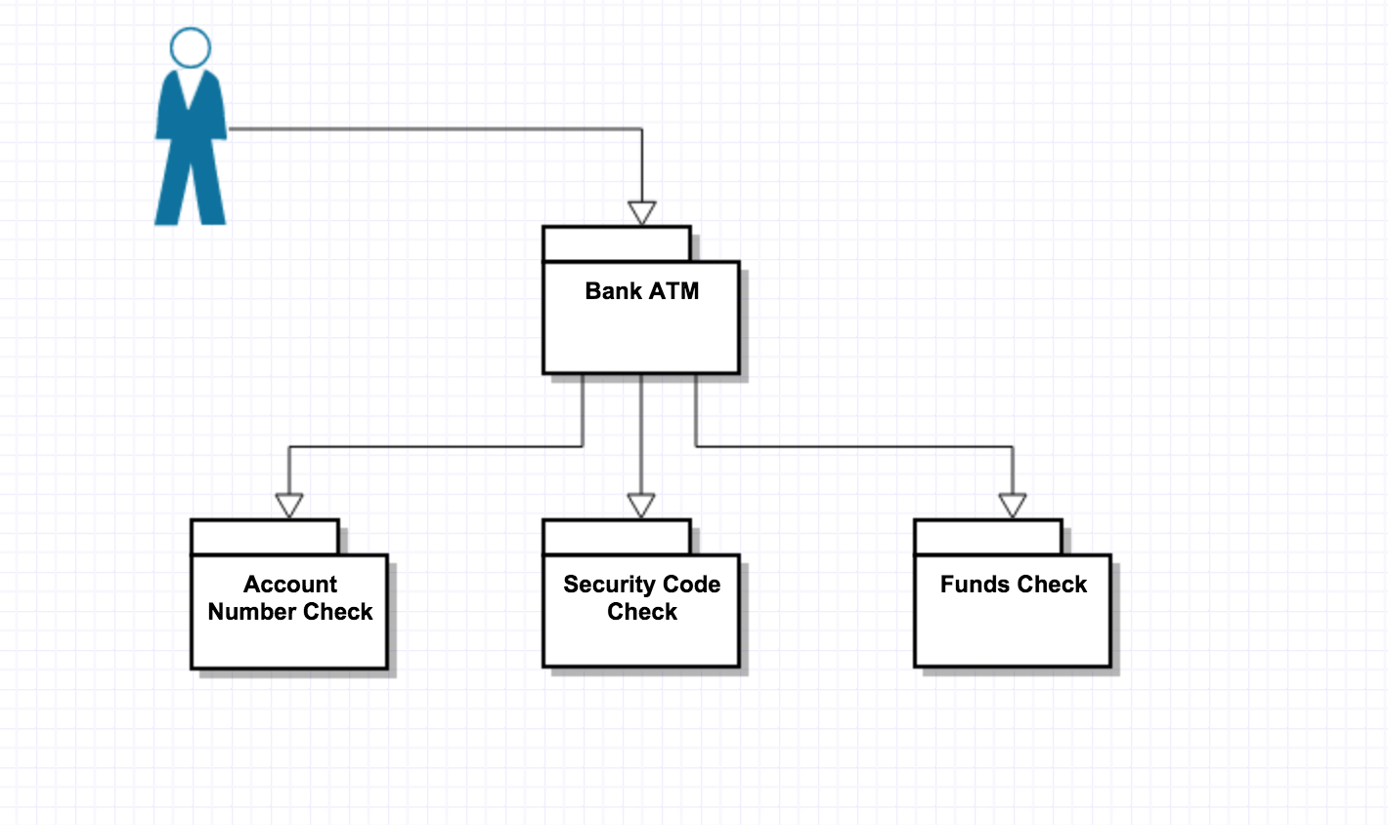
Banking ATM Facade

Slide 6
Motivation
The interface exposed by the classes in a subsystem or set of subsystems can become quite complex
To reduce this complexity, introduce a facade object that provides a simplified and single interface to access facilities of a system.

Slide 7
Motivation
Compiler system
Some specialized applications might need to access these classes directly. But most clients of a compiler generally don't care about details and want to simply compile the code
Having to deal with these low-level interfaces would only complicate their work with no extra benefit

Slide 8
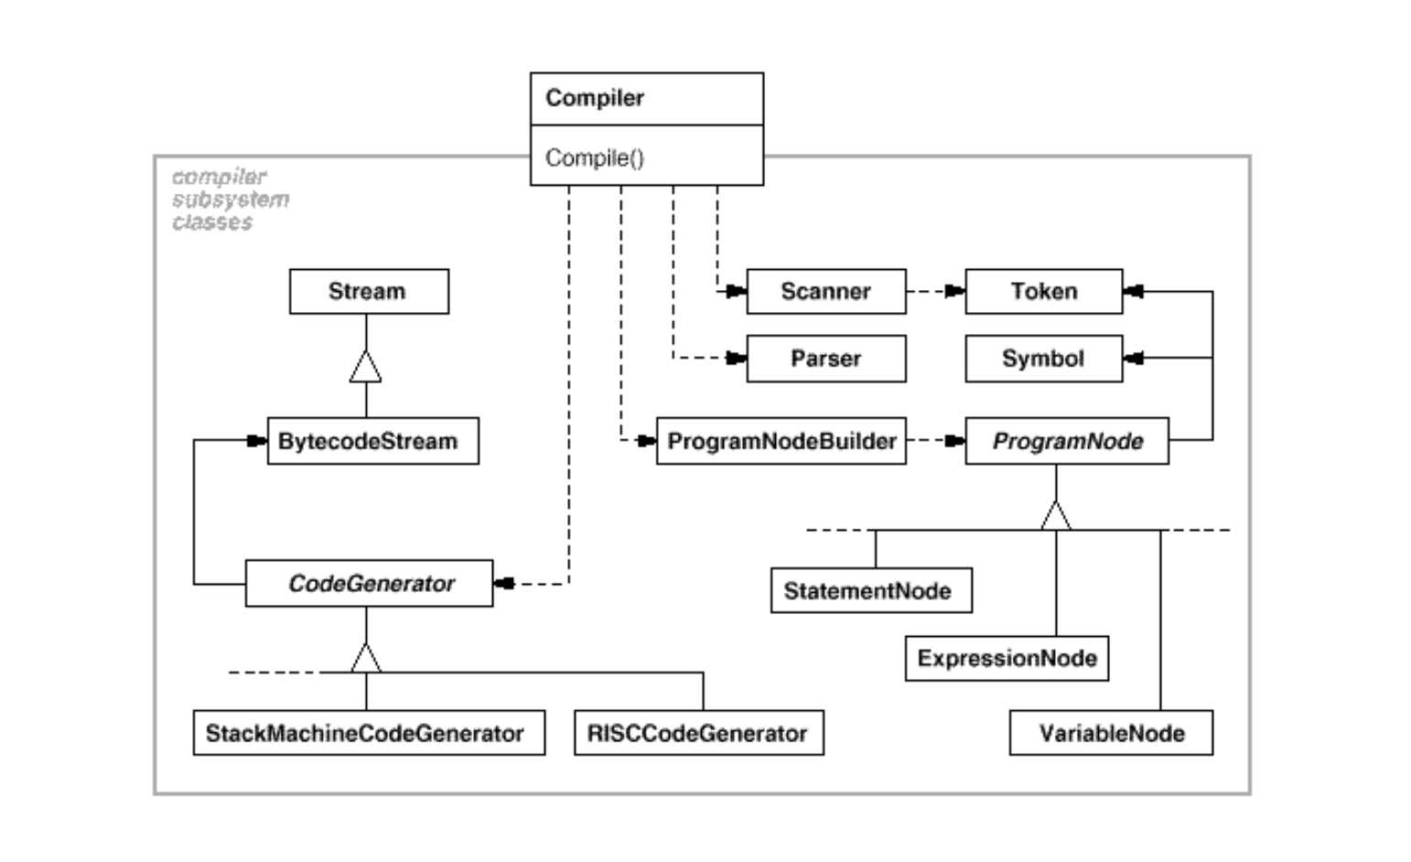
Motivation

Slide 9
Motivation
The Compiler class acts as a facade: It offers clients a single, simple interface to the compiler subsystem
It glues together the classes that implement compiler functionality without hiding them completely
The compiler facade makes life easier for most programmers without hiding the lower-level functionality from the few that need it.

Slide 10
Applicability
Provides simple interface to complex subsystem
Decouples subsystems from clients and other subsystems
Helps in layering the subsystem
Reduces the number of objects clients have to deal with
Minimizes subsystem dependencies hence promoting portability

Slide 11
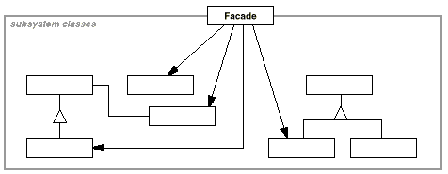
Structure
A
B
C
D

Slide 12
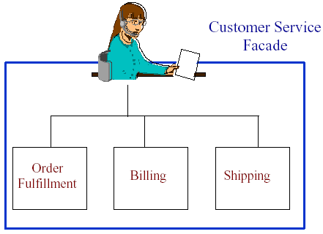
Structure Cont.
Customer Service Representative
Provides a unified interface to each of the departments involved in a transaction

Slide 13
Participants
Facade Class (Compiler)
knows which subsystem classes are responsible for a request
delegates client requests to appropriate subsystem objects

Slide 14
Participants
Subsystem Class (Scanner,Parser etc)
implement subsystem functionality
handle work assigned by Facade object
have no knowledge of the facade; that is, they keep no reference to it

Slide 15
Collaboration
Clients communicate with the subsystem by sending requests to Facade.
The Facade forwards the requests to the appropriate subsystem object(s).

Slide 16
Collaboration
Although the subsystem objects perform the actual work, the facade may have to do work of its own to translate its interface to subsystem interfaces.
Clients that use the facade do not have to access its subsystem objects directly.

Slide 17
Consequences
It shields clients from subsystem components. This makes the subsystem easier to use.
It promotes weak coupling between the subsystem and its clients.
Weak coupling lets you vary the components of the subsystem without affecting its clients

Slide 18
Consequences
Reduces compilation dependencies in the large software systems.
It does not prevent applications from using subsystem classes if they need to.
It does not add much functionality but simplifies the interface.

Slide 19
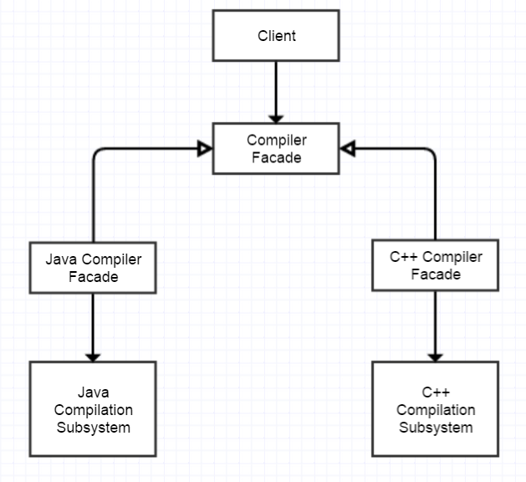
Implementation
Reducing client –subsystem coupling : Make the Facade an abstract class.

Slide 20
Implementation
Public versus private subsystem classes:
Clients could access public interface of the subsystem through facade and we can expose the private interface for subsystem extenders.

Slide 21
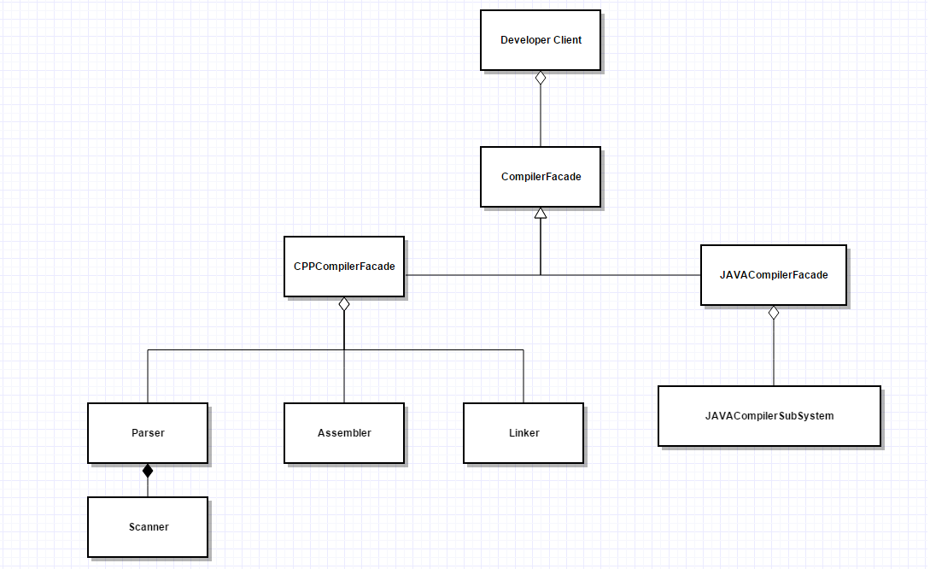
Abstract Compiler Facade

Slide 22
Known uses
Almost every system you ever designed
Socket Programming
Compiler shown earlier eg. smalltalk
Application Server like Chess Program , Tic-Tac Toe
Virtual memory framework: Domain for address spaces

Slide 23
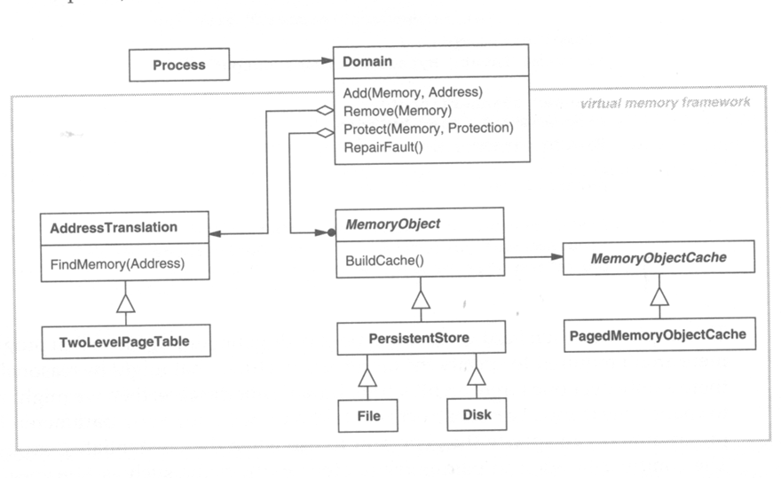
VIRTUAL MEMORY FRAMEWORK

Slide 24
RELATED PATTERNS
Facade Vs. Adapter Design Pattern
Facade deals with multiple classes and Adapter deals with one
Adapter converts an interface and facade simplifies one
Questions:
Are there pre-existing classes?
Is there an interface we must design to?
Does an object need to behave polymorphically?
Is a simpler interface needed?

Slide 25
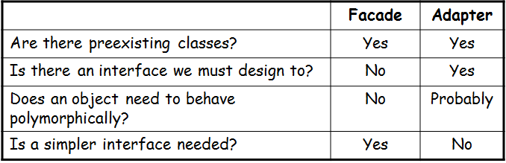
RELATED PATTERNS

Slide 26
RELATED PATTERNS
Facade Vs Mediator Design Pattern
Mediator also abstracts the functionality of the subsystem in similar manner to facade.
Mediator pattern the subsystem is aware of the mediator and more complex than Facade.
Facade the subsystem does not know anything about the facade. It’s a one way communication from Facade to subsystem

Slide 27
Why Abstract Factory over Facade?
Abstract Factory can also be used as an alternative to Facade to hide platform-specific classes.
Can we use Singleton?
Facade objects are often Singletons

Slide 28
SUMMARY
Facade provides a single interface.
Programmers comfort is a main purpose of facade.
Simplicity is the aim of facade pattern.
Subsystem may be dependent with one another. In such case, facade can act as a coordinator and decouple the dependencies between the subsystems.
Translating data to suit the interface of a subsystem is done by the facade.

Slide 29
QUESTIONS?

Slide 30
Thank You!!

